Slide 1

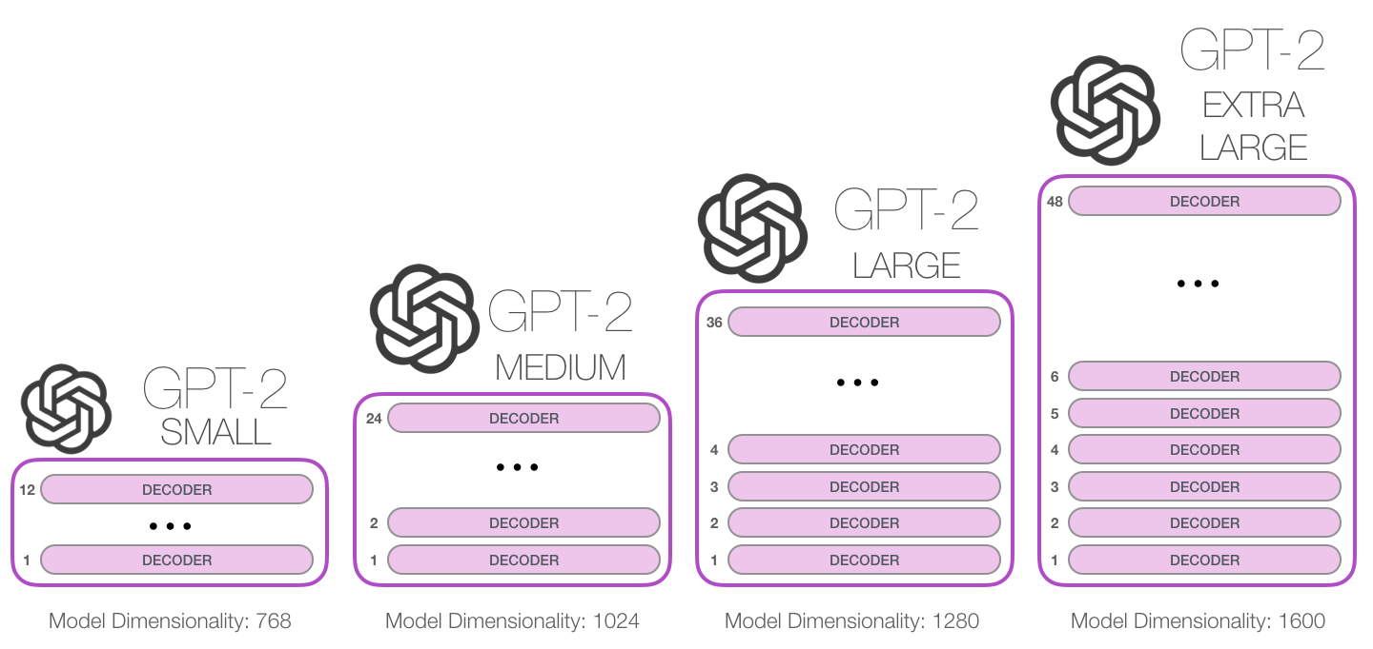
Computer Science Department
Final Project: Project title
Course: Introduction to AI (CS156s4)
Course Instructor: Yulia Newton, Ph.D.
Lawrence Nguyen
Introduction/Background
Methodology
Analysis and Results
Starter: People have been telling me about
People have been telling me about this for a long time. People who were here today and pro worker policies, our economy is breaking one record after another. Since my election, we have created over 6 million new jobs. We have created over 750,000 jobs right here in Texas and very importantly, that includes 70,000 new Texas manufacturing jobs. They said that couldn't be done. Unemployment … Think of this.
These three snippets are chosen because of their uniqueness, but most of the other snippets contain references to other foreign powers, especially India. Texas is the only American location mentioned in these generated snippets. This theme was also present in the samples generated during training.
The problem this project is trying to approach is Natural Language Generation, or NLG for short. NLG is a subcategory of Natural Language Processing, NLP, where the prediction output is natural human language. In this problem we will be using English, but NLG has been applied with thousands of international languages. For example, Google’s translation application uses NLG to rewrite direct translations from languages into something the user can understand. NLG can also be used for next phrase prediction, similar to how the phones offer autocorrect or suggestions for the next words the user can use.
In this project, I will try to generate Trump-like sentences from a few words of starting text.
Algorithm
This project implements a pretrained model called GPT- 2 which is an open source project by OpenAI. This model is an ultra massive neural network designed for this exact problem.
In this project, I used GPT-2, which is the smallest, most light-weight version seen in Figure 1. I chose this model because Google Colab does not have the storage available for me to use any bigger version. The GPT-2 Small model is about 500MB in size. The tradeoff for being so small is that the resulting text generated from this model will not be as human like compared to larger models. However, the results are still good enough to justify its use
Training results
Thanks to the GPU provided by Google Colab, 1000 epochs of training only took about 70 minutes to complete. Between the first and tenth epoch the average loss was roughly 0.35. After the next ten epochs, the loss dropped drastically to an average of 0.03. Over the next 990 epochs, the average loss fluctuated between 0.01 and 0.03, which made me feel that training beyond 20 epochs was a mistake.
During training, a default setting is for the model to print a sample snippet of text every 10 epochs. However, I accidentally deleted the resulting output of the training cell. The samples seemed very realistic and similar to what the test results yielded.
Testing Results
To test out the fine-tuned model, I was able to input some starting text into a function that would subsequently use the model to generate 5 different instances of text of specified length.
The following are some examples taken from the notebook:
Starter: The border wall
The border wall. Voter ID. It's all there is to it. It's called "Made in the USA." And very soon, India will have access to another world class American product, NBA basketball. Wow, sounds good. That sounds good. Next week thousands of people will gather in Mumbai to watch the first ever NBA basketball game in India. Am I invited, Mr. Prime Minister? I may come. Be careful. I may come. When it comes to expanding our commercial relationship, no issue is more important than energy security.
Starter: You want to know what is really incredible?
You want to know what is really incredible? Nations around the world are investing in the United States because they know we have the best economy and the best workers in the world. They have never invested in our country like they are today. And we want to thank everybody and India has never invested in the United States like it is doing today. And I want to say it's reciprocal because we're doing the same thing in India.
Figure 1: The architecture of different sized GP2-2 Models
Summary/Conclusions
Overall, the resulting text turned out much better than I was expecting it to. The majority of the snippets sound like they could have been spoken during campaign rallies, however there are a few common themes that always seem to appear. One factor that could contribute to this would be the ordering of the data. Perhaps if I had randomized the order of the paragraphs in each speech, there would be less common threads present.
Dataset description
The dataset I chose for this project is a compilation of Trump rally speeches that are date from mid to late 2020. Each speech is transcribed word for word, including his stutters, in its own text document. Each speech is roughly 17,000 words in length and the dataset has a total of 35 speeches.
Since the training method, which will be discussed in the next section, I used automatically splits the data into training and validation sets so I did not have to do that myself. The only data manipulation I did was concatenating all of the text files into one.
Radford, Alec. “Better Language Models and Their Implications.” OpenAI, OpenAI, 21 June 2021, https://openai.com/blog/better-language-models/.
Key References
Application to the project
To apply this algorithm to the project, I first needed to download a pre-trained model. I used this python package to download a GPT-2 small model. Afterwards, I needed to fine-tune this model to with my data. The training function of this model takes only one file, so I first needed to write the contents of every single text file in my data into a single file that would be used for training. Afterwards, I fine-tuned this model for 1000 epochs, which ended up being far too much. 20 epochs would have resulted in very similar results. The resulting model was able to generate realistic paragraphs from starting text.
Acknowledgements
Thank you, Professor Newton, for teaching an incredible AI class!

